Slide 1

The Node Way
Zacky Pickholz
Expert Days
Dec-2015

Slide 2
INTRO
Notes:
A nice example of Express and socket.io
178.62.63.118
http://node1.codebyz.com
ssh root@178.62.63.118
PS2
Digital ocean referral link: https://www.digitalocean.com/?refcode=f7b5d34a0a5c

Slide 3
Overview
What’s it about | Topic
Just watched it | Quick Intro
Our very own Node cloud instance | Setting Up our Server
Some WH Questions (who, why, when…) | Node Background
A visit to the engine room | Under The Hood
Globals, utils, logging, events, errors, debugging. Good stuff. | Essential Node
Things to make our life easier | Practicalities
Series, full parallel, limited parallel | Control flow patterns
An intro to promises | Promises
The bluebird promises package | Bluebird
All we must know on Node’s Package Manager | NPM
Creating our own packages | Node Modules
Bidirectional event-based communication. Real stuff. | socket.io
Intro to Node’s most popular Web Application Framework. Neat. | Express
If time allows | Advanced topics

Slide 4
SETTING UP our server
Notes:
Digital ocean referral link: https://www.digitalocean.com/?refcode=f7b5d34a0a5c

Slide 5
Setting up node
Setup cloud account (DigitalOcean)
Spin an instance (Ubuntu)
Login via serveraudit
Install node & npm
sudo apt-get update
sudo apt-get install nodejs
sudo apt-get install npm

Slide 6
The Amature Packet Radio Node Package
Due to allegedly naming conflict
On some distributions node has been renamed to nodejs
We can sort this out by doing:
sudo ln -s /usr/bin/nodejs /usr/bin/node

Slide 7
REPL – Read Eval Print Loop
A way to interactively run JavaScript code & see results
Why does it print undefined?
For debugging, testing, or just trying things out
Invoking: node <enter>
Defines a list of built-in libraries
exports._builtinLibs = ['assert', 'buffer', 'child_process', 'cluster', 'crypto', 'dgram', 'dns', 'events', 'fs', 'http', 'https', 'net', 'os', 'path', 'punycode', 'querystring', 'readline', 'repl', 'string_decoder', 'tls', 'tty', 'url', 'util', 'vm', 'zlib'];
Notes:
https://github.com/joyent/node/blob/f210530f46e8ddbd9e7cc0d0c37778888c27f526/lib/repl.js#L72-75

Slide 8
nano
Command | Operation
nano | Run nano
nano -u | Run nano in experimental mode
CTRL + K | Delete Line
Middle Mouse Click | Paste
CTRL + O | Save (Write Out)
CTRL + X | Exit
ALT + U | Undo (*experiential mode only)

Slide 9
My First Server - HTTP
var http = require('http'); // import the http package
// start a web server listening on port 80
http.createServer(function(req, res) {
// send http content type and status code
res.writeHead(200, {'Content-Type': 'text/plain'});
// send http content type and status code
res.end(‘Hola Mundo!');
}).listen(80);
// just a console message
console.log('Server running on port 80');

Slide 10
My First Server – TCP Server
var net= require('net'); // import the net package
// create the socket server (note we’re saving it to a variable this time)
var server = net.createServer(function (socket) {
// greet user
socket.write(welcome!\r\n');
// data ready event - echo it back to the socket
socket.on('data', function(chunk) {
socket.write(chunk);
});
// client closed the connection - close our end as well
socket.on('end', socket.end);
});
// start the server – listen on port 1337 on all local interfaces
server.listen(1337, '0.0.0.0');
// just a console message
console.log('Server running on port 1337');
Notes:
node socket.js &
telnet localhost 1337

Slide 11
Node background

Slide 12
What is Node.js
Open source, cross-platform runtime environment
Used to easily build fast, scalable server-side and networking applications
Node.js is written in C++
Node.js applications are written in JavaScript
In fact many of its modules are also written in JS
Uses an event-driven, non-blocking I/O
model that makes it lightweight and efficient
Highly scalable & high throughput
Has built-in library to allow apps act as Web server

Slide 13
Current Stable Version
V5.3.0
15-12-2015
Notes:
http://blog.nodejs.org/

Slide 14

Who’s Behind Node
Created by Ryan Dahl sponsored by Joyent
Initiated in search for good push capabilities
First published for Linux in 2009
NPM was introduced in 2011
Today still managed by Joyent

Slide 15
When Node Should Be Used
For data-intensive real-time applications running across distributed devices
Online games, Chat, Data streaming
Stock trading dashboards
Leader boards
Message pushing
Messaging applications
AJAX heavy mobile/desktop SPAs (single page applications)

Slide 16
More Reasons Why to Node
Where we need a persistent server-browser connection
When end-to-end JavaScript is required
When we want code reuse across client/server
When we want a JSON API (Gmail)
Node.js is great for when you have I/O bound work, not CPU bound

Slide 17
When Node Should NOT Be Used
Heavy server-side computation/processing
CPU intensive operation annuls the throughput benefits of Node
Heavy computation should be offloaded to background processes
Simple CRUD HTML apps
There are much better alternatives
Django, Laravel, Ruby, …

Slide 18
Who Uses Node?
Trello
Walmart (modern front-end experience)
eBay
UBER (real time logistics)
New York Times (mobile)
PayPal
Microsoft (Azure)
LinkedIn (mobile)
Zacky

Slide 19
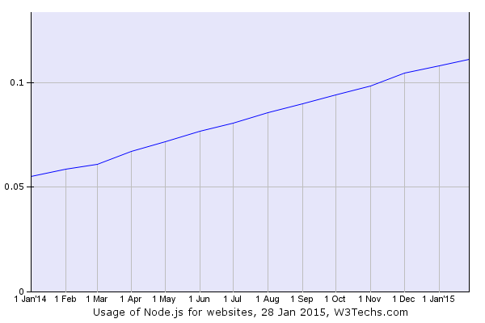
Historical Trend (%)
Notes:
http://w3techs.com/technologies/details/ws-nodejs/all/all

Slide 20
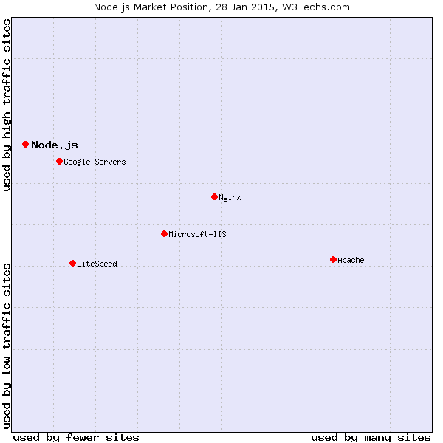
Market Position
Notes:
http://w3techs.com/technologies/details/ws-nodejs/all/all

Slide 21
Under the hood

Slide 22

The Javascript Engine
Built on JavaScript runtime (v8)
Written in C++
Developed by Google for Chrome
Compiles JS to native machine code before executing it
instead of interpreting it and directly executing it from the FS
Runs extensive code optimizations
Extremely fast and efficient
Notes:
http://www.ning.com/code/2010/02/benchmarking-javascript/
http://arewefastyet.com/#machine=28

Slide 23
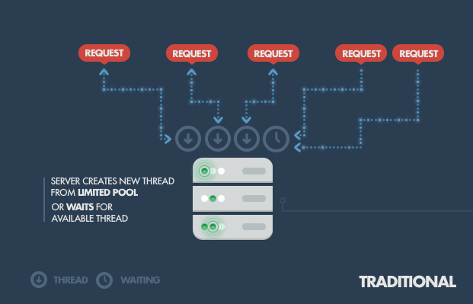
Traditional Web Servers
Each connection (request) spawns a new thread, taking up system RAM

Slide 24
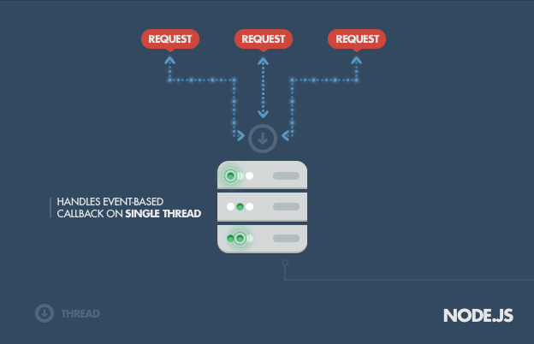
Node
single-thread, using non-blocking I/O calls, allowing it to support tens of thousands of concurrent connections

Slide 25
What It Means
Node can keep many connections alive transparently
Without having to reject new incoming connections
Handling a huge number of simultaneous connections
High Throughput → High Scalability
Example: System with 8 GB of RAM
With ~2MB/thread → limited to 4K concurrent connections
While Node can theoretically reach 1M (POC) *
Practically tens of thousands as opposed to thousands on traditional
* This of course does not necessarily mean low response time.
Notes:
http://blog.caustik.com/2012/08/19/node-js-w1m-concurrent-connections/

Slide 26
Non Blocking I/O
Node’s approach: all I/O activities should be non-blocking (async)
Because I/O is the most expensive operation (remember L1, L2, RAM, FS, Network?)
This means that all these:
HTTP requests, DB queries, file I/O, other things that require waiting…
Run independently and do not halt execution

Slide 27
Non Blocking I/O – Cont.
The runtime handles their operation (transparently)
And when data is ready an event is placed on the event loop
Which, when processed, calls your app’s callback/closure

Slide 28
The Event Loop
A fundamental part of Node (and JS)
JS needed that to do onclick, onmouseover etc.
The system JS uses to deal with incoming requests (events)
A similar concept to context-switching
There is only one thing happening at once
Runs on LibUv

Slide 29
The Event Loop – Cont.
I/O calls are the points at which Node.js can switch from one request to another
At an I/O call, your code saves the callback and returns control to the node.js runtime environment
The callback will be called later when the data actually is available

Slide 30
The Event Loop – Illustration*
*oversimplified of course
// on an IO worker thread
lock (queue) {
queue.push(event);
}
// on the main JavaScript thread (on the C side of things)
while (true) {
// this is the beginning of a tick
lock (queue) {
var tickEvents = copy(queue); // copy the current queue items into thread-local memory
queue.empty(); // ..and empty out the shared queue
}
for (var i = 0; i < tickEvents.length; i++) {
InvokeJSFunction(tickEvents[i]);
}
// this the end of the tick
}
Notes:
http://blog.caustik.com/2012/08/19/node-js-w1m-concurrent-connections/

Slide 31
The Single Thread Thing
Node is single threaded (not 100% true, next slide)
All clients (in your app) share that thread
Heavy computation can choke it up
Cause problems for all clients
Incoming requests blocked while computing
And also… Exceptions
An unhandled exception on one client
Bubbling up to the topmost Node.js event loop
Will terminate Node.js instance
Effectively crashing the program

Slide 32
Seriously? One Thread?
No. Actually there are more threads
But they are transparent
Your app runs on single thread
I/O operations on other threads
A pool of I/O worker threads receive I/O interrupts and put corresponding events into the queue to be processed by the main thread
 | Library
Mantains and manages the event loop and the I/O events | LibUv
A library performing input/output asynchronously | LibEio
Notes:
http://rickgaribay.net/archive/2012/01/28/node-is-not-single-threaded.aspx
http://stackoverflow.com/questions/9497076/how-node-js-works
http://stackoverflow.com/questions/10680601/nodejs-event-loop

Slide 33
ESSENTIAL NODE

Slide 34
Globals *
* Available in all modules
Usage / Functionality | Name
GLOBAL._ = require('underscore'); | Global/GLOBAL
process.argv.forEach(function(val, index, array) { … } Process.abort(); process.on('exit', function(code) { … } process.on('uncaughtException', function(err) { … } | process
console.log,(…), console.error(…) console.time(‘task’), console.timeEnd(‘task’) | console
Useful for handling octet streams (i.e. TCP apps) | buffer (class)
To require (load and use) modules | require()
console.log(__filename); // absolute path & filename of code being executed – e.g. /opt/myapps/mymodule.js | __filename
Directory name of currently executing script | __dirname
A reference to current module. Used for module.exports A reference to the module.exports that is shorter to type | module exports
Run a callback after at least X ms | set/clearTimeout
Repeatedly run a callback every ~X ms | set/clearInterval,
Notes:
http://nodejs.org/api/globals.html

Slide 35
Core Utilities (some)
Usage / Functionality | Name
Asynchronous network wrapper for creating servers & clients. Methods: net.createServer(), net.connect(), … Classes: net.Server, net.Socket | net
Methods: http.createServer(), http.createClient(), … Classes: http.Server, http.ServerResponse, … | http
Utilities for handling and transforming file paths path.join('/code', by',Z', ‘nodejs’); // 'code/by/Z/nodejs' | path
Utilities for URL resolution and parsing url.parse() // returns object with parsed fields (protocol, hostname, path, query, …) url.format() // take a URL object, return formatted URL string | url
Methods: inherits, format (printf), isArray, isDate, print (synchronous), error, log, inspect (object to string) | util
Cryptographic utilities (for security / credentials handling etc.) | crypto
File I/O operation wrappers. Methods: read, chown, chmod, watchFile, … | fs

Slide 36
Basic File Handling [fs]
// the async way
var fs = require("fs");
fs.readFile("foo.txt", "utf8", function(error, data) {
console.log(data);
});
// the sync way (bit of a rarity in Node’s event driven world)
var fs = require("fs");
var data = fs.readFileSync("foo.txt", "utf8");
console.log(data);

Slide 37
Accessing MySql [mysql]
var mysql = require('mysql');
var connection = mysql.createConnection({
host : 'localhost',
user : 'me',
password : ‘super^secret'
});
// note that every method you invoke on a connection is queued and executed in sequence
connection.connect(function(err) {
if (err) { console.error('error connecting: ' + err.stack); }
});
connection.query('SELECT 1 + 1 AS solution', function(err, rows, fields) {
if (err) throw err;
console.log('The solution is: ',s rows[0].solution);
});
connection.end(); // terminate gracefully
Notes:
https://github.com/felixge/node-mysql

Slide 38
Accessing Redis[redis]
var redis = require("redis"),
client = redis.createClient();
client.on("error", function (err) {
console.log("Error " + err);
});
// We’re connected, run our sample
client.on("connect", runSample);
function runSample() {
// Set a value
client.set("hola", "Hello World", function (err, reply) {
console.log(reply.toString());
});
// Get a value
client.get("hola", function (err, reply) {
console.log(reply.toString());
});
}
Notes:
https://github.com/felixge/node-mysql

Slide 39
Logging [winston]
/*******************
* File: loggy_the_log.js
*******************/
var winston = require('winston');
var logger = new (winston.Logger)({
transports: [
new (winston.transports.Console)({ level: 'error' }),
new (winston.transports.File)({ filename: 'path/to/all-logs.log' })
],
exceptionHandlers: [
new (winston.transports.File)({ filename: 'path/to/exceptions.log' })
]
});
module.exports = logger; // remember module.exports from few slides back?

Slide 40
Logging – Cont.
// console.log is for kids! we’re using winston!
var loggy = require('./loggy_the_log');
// some critical application logging
loggy.log('debug', "127.0.0.1 - there's no place like home");
// this will go to the console as well
loggy.error("127.0.0.1 - there's no place like home");

Slide 41
Emitting Events
Many objects in Node emit events
All objects which emit events are instances of events.EventEmitter
listener functions can be attached to objects, to be executed when an event is emitted
Inside a listener function, this refers to the EventEmitter

Slide 42
Emitting Events – Cont.
var util = require("util"),
events = require("events");
// create a MyStream class
function MyStream() {
events.EventEmitter.call(this); // call super-class EventEmitter’s constructor
}
// inherit EventEmitter’s prototype
util.inherits(MyStream, events.EventEmitter);
// define a “write” method
MyStream.prototype.write = function(data) {
this.emit(“yo new data", data); // emit a “yo new data” event
}
// create an instance of MyStream
var mystream = new MyStream();
// attach an event listener on event data
mystream.on("yo new data", function(data) {
console.log('Received data: "' + data + '"');
})
mystream.write("It works!"); // Will cause emitting of “yo new data” event

Slide 43
Listening on Events
// listener function
function onConnected(stream) {
console.log(‘someone connected’);
}
// attach the listener func
server.on('connection', onConnected);
// same as above.
// note that calling any of these funcs more than once
// will cause multiple same listeners
server. addListener('connection', onConnected);

Slide 44
Listening on Events – Cont.
// adds a one time listener for the event
emitter.once(event, listener);
// remove one instance of a listener from the listeners array
emitter.removeListener(event, listener)
// removes all listeners [or those of the specified event]
emitter.removeAllListeners([event])

Slide 45
Error Delivery Methods - Jungle
Pass the error to a callback - common // callback(err, result). only one of err and result is non-null callback(new Error('something bad happened'));
emit an "error" event on an EventEmitter - common
throw an Error object – less common throw new Error('something bad happened');
throw something else (string) – bad practice
As you can see error handling in Node is still a bit of a jungle…
Notes:
https://www.joyent.com/developers/node/design/errors#footnote-1

Slide 46
Process Wide Exception Handling
// listen to events on the global process variable
process.on('uncaughtException', function(err) {
console.log('Threw Exception: ', err);
console.log('Stack Trace: ‘, err.stack);
});
Discouraged. Use proper in-place error handling instead
After it’s emitted Node would either crash or be in unknown state
So don’t use it, but if you do then restart your application!
npm modules such as forever can be used to restart node gracefully when uncaughtException is emitted

Slide 47
Domain Wide Exception Handling
Domains are a new Node module
Still unstable
Provide a way to handle multiple different IO operations as a single group
var domain = require('domain').create();
domain.on('error', function(err){
console.log(err);
});
domain.run(function() {
throw new Error('thwump'); // anything thrown here caught above
});

Slide 48
Exception Handling with Try/Catch
Word of caution
Only works with synchronous code
try {
throw new Error('thwump');
} catch (e) {
console.log(e);
}

Slide 49
Debugging [node-inspector]
Node Inspector: a debugger interface for Node.js apps that uses the Blink Developer Tools (formerly WebKit Web Inspector)
npm install -g node-inspector
node-inspector & // run in bg
node --debug app.js // or --debug-brk
http://178.62.63.118:8080/debug?port=5858
Browser
Node Inspector
Your App
8080
5858

Slide 50
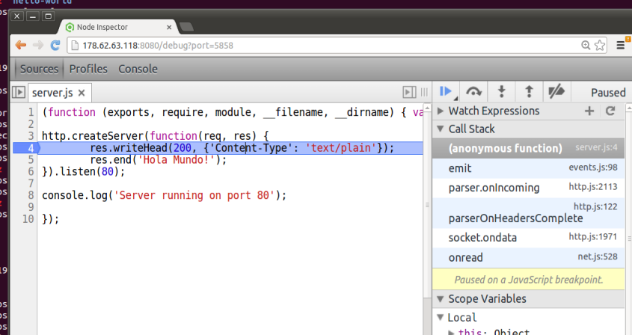
Debugging – Webkit Inspector

Slide 51
Hands on time

Slide 52
PRACTICALITIES

Slide 53
Keeping Node Running
// nohup (no hang-up on SSH exit)
nohup node app.js &
// forever (but what happens after reboot?)
npm install forever –g
forever start app.js
forever stop app.js
// pm2
npm install pm2 –g
pm2 start app.js
pm2 stop app.js
// nodemon
npm install -g nodemon
nodemon app.js

Slide 54
nodemon vs. forever / pm2
Generally speaking:
nodemon is for development
pm2 and forever are for production
Recommendation: pm2 is better for prod
Can we use nodemon AND forever?
If you insist:
forever start -c nodemon myapp.js

Slide 55
Surviving a Reboot
With PM2 your life is a breeze
pm2 start /var/www/myapp.js
pm2 startup
To make changes to startup later on do:
pm2 save

Slide 56
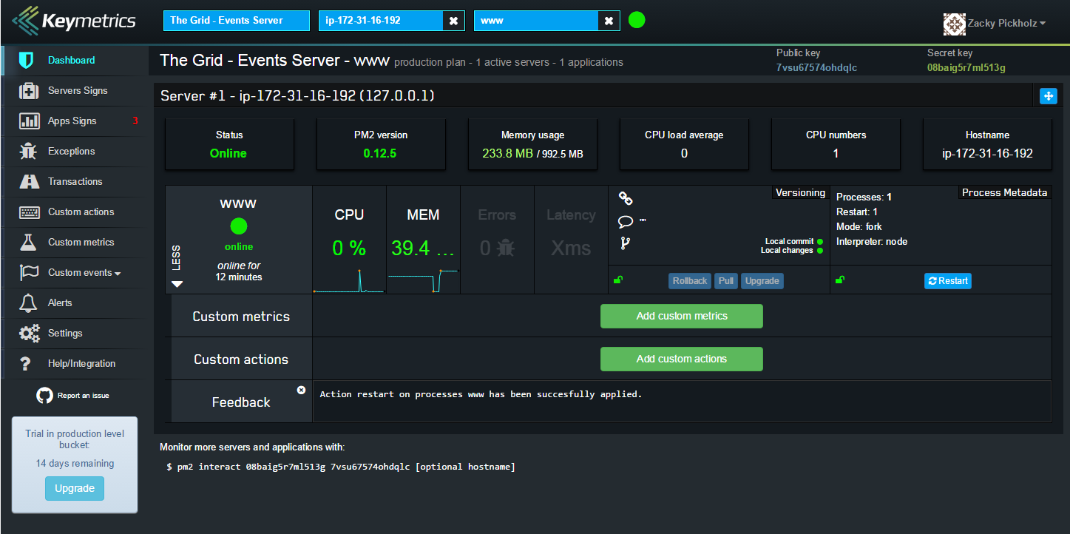
PM2 Monitoring Dashboard (paid service)
pm2 interact 08baig37ml513g 7vsu67574ohd3lc
Notes:
https://app.keymetrics.io/#/

Slide 57
Hair Savers
nodejs or node ???
On Ubuntu 14 node was renamed to nodejs…
create a soft link
sudo ln -s /usr/bin/nodejs /usr/bin/node
Anti Virus programs might block socket.io
Avast is notorious, so be aware
node-inspector might not work properly on Windows
Are you running anti spyware?
Check your firewall
Switch to Linux already

Slide 58
CONTROL flow patterns
Notes:
http://book.mixu.net/node/ch7.html

Slide 59
Series – Run Calls Sequentially
// Async task (e.g. perform DB query)
function async(arg, callback) {
console.log('do something with \''+arg+'\', return 1 sec later');
setTimeout(function() { callback(arg * 2); }, 1000);
}
// Final task (same in all the examples)
function final() { console.log('Done', results); }
// A simple async series:
var items = [ 1, 2, 3, 4, 5, 6 ];
var results = [];
function series(item) {
if(item) {
async( item, function(result) {
results.push(result);
series(items.shift());
});
} else {
final();
}
}
series(items.shift());
Notes:
http://book.mixu.net/node/ch7.html

Slide 60
See it in action…
http://jsfiddle.net/

Slide 61
Series - Explanation
We take a set of items and call the series control flow function with the first item.
The series launches one async() operation and passes a callback to it.
The callback pushes the result into the results array and then calls series with the next item.
When the items array is empty, we call the final() function.

Slide 62
Full Parallel – Wait for All To Complete
function async(arg, callback) {
console.log('do something with \''+arg+'\', return 1 sec later');
setTimeout(function() { callback(arg * 2); }, 1000);
}
function final() { console.log('Done', results); }
var items = [ 1, 2, 3, 4, 5, 6 ];
var results = [];
items.forEach(function(item) {
async(item, function(result){
results.push(result);
if(results.length == items.length) {
final();
}
})
});
Notes:
http://book.mixu.net/node/ch7.html

Slide 63
See it in action…
http://jsfiddle.net/

Slide 64
Full Parallel - Explanation
Start async operation for all items immediately
Async is passed an anonymous function that
Stores the result
Checks if we have all results
If yes → call final function
CAUTION: since we run all I/O ops in parallel we need to be careful not to exhaust the available resources

Slide 65
Limited Parallel – Don’t Exhaust I/O
function async(arg, callback) {
console.log('do something with \''+arg+'\', return 1 sec later');
setTimeout(function() { callback(arg * 2); }, 1000);
}
function final() { console.log('Done', results); }
var items = [ 1, 2, 3, 4, 5, 6 ];
var results = [];
var running = 0;
var limit = 2;
function launcher() {
while(running < limit && items.length > 0) {
var item = items.shift();
async(item, function(result) {
results.push(result);
running--;
if(items.length > 0) {
launcher();
} else if(running == 0) {
final();
}
});
running++;
}
}
launcher();
Notes:
http://book.mixu.net/node/ch7.html

Slide 66
See it in action…
http://jsfiddle.net/

Slide 67
Limited Parallel - Explanation
We start new async() operations until we reach the limit (2)
Each async() operation gets a callback which
stores the result
decrements # of running operations
checks whether there are items left to process
If yes → run laucher() again
If no items to process & current op was last one → call final()

Slide 68
promises

Slide 69
What are Promises?
Represents a proxy for a value unknown when the promise is created
Allows writing asynchronous code in more synchronous fashion
Instead of the final value, the asynchronous method returns a promise
Interface
new Promise(function(resolveHandler, rejectHandler) { ... });
Any of the handlers can be null

Slide 70
The Pyramid a.k.a Callback Hell *
* one reason to use promises
server.on('request', function(req, res) {
//get session information from memcached
memcached.getSession(req, function(session) {
//get information from db
db.get(session.user, function(userData) {
//some other web service call
ws.get(req, function(wsData) {
//render page
page = pageRender(req, session, userData, wsData);
//output the response
res.write(page);
});
});
});
});
Notes:
https://www.npmjs.com/package/bluebird
https://github.com/petkaantonov/bluebird/blob/master/API.md

Slide 71
Promises Turn This
* one reason to use promises
fs.readFile("file.json", function(err, val) {
if( err ) {
console.error("unable to read file");
}
else {
try {
val = JSON.parse(val); // Q: why can we use try/catch here?
console.log(val.success);
}
catch( e ) {
console.error("invalid json in file");
}
}
});
Notes:
https://www.npmjs.com/package/bluebird
https://github.com/petkaantonov/bluebird/blob/master/API.md

Slide 72
Into This
var fs = Promise.promisifyAll(require("fs"));
fs.readFileAsync("file.json").then(JSON.parse).then(function(val) {
console.log(val.success);
})
.catch(SyntaxError, function(e) {
console.error("invalid json in file");
})
.catch(function(e){
console.error("unable to read file")
});
Notes:
https://www.npmjs.com/package/bluebird
https://github.com/petkaantonov/bluebird/blob/master/API.md

Slide 73
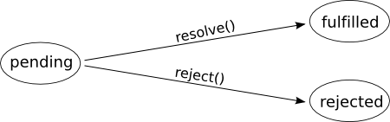
Promise States
Settled

Slide 74
Promise States – Cont.
When pending, a promise:
may transition to either the fulfilled or rejected state.
When fulfilled, a promise:
must not transition to any other state.
must have a value, which must not change.
When rejected, a promise:
must not transition to any other state.
must have a reason, which must not change.

Slide 75
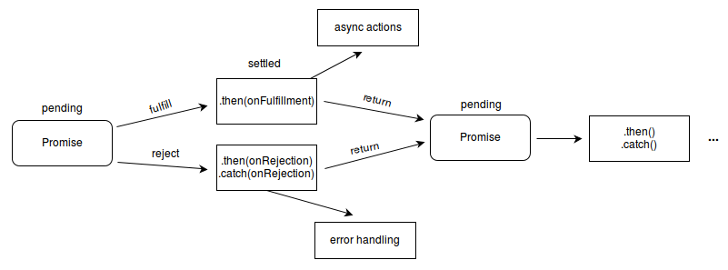
Chaining Promises
As the Promise.then() and Promise.catch() methods return promises, they can be chained, an operation called composition.

Slide 76
Promises Libraries
Author | Name
Petka Antonov | Bluebird
Calvin Metcalf | Catiline
The jQuery Foundation | jQuery
Jake Archibald | ES6 Promise Polyfill
The Obvious Corporation | Kew
Calvin Metcalf | lie
RubaXa | MyFederred
Cho45@lowreal.net | MyPromise
Kris Kowal | Q
Tilde | RSVP
cujoJS | When
Yahoo! | Yui
Notes:
https://www.npmjs.com/package/bluebird
https://github.com/petkaantonov/bluebird/blob/master/API.md

Slide 77

Bluebird promises

Slide 78
Bluebird
The most feature rich promises library around
Not just for Node, can also be used in the browser (same as most promise libraries)
npm install bluebird
var Promise = require("bluebird");
Notes:
https://www.npmjs.com/package/bluebird
https://github.com/petkaantonov/bluebird/blob/master/API.md

Slide 79
Basic Usage
var fs = Promise.promisifyAll(require("fs"));
fs.readFileAsync("file.json").then(JSON.parse).then(function(val) {
console.log(val.success);
})
.catch(SyntaxError, function(e) {
console.error("invalid json in file");
})
.catch(function(e){
console.error("unable to read file")
});
Notes:
https://www.npmjs.com/package/bluebird
https://github.com/petkaantonov/bluebird/blob/master/API.md

Slide 80
Collections - all
Given an array, return a promise fulfilled when all items are fulfilled
If any promise in the array rejects, the returned promise is rejected with the rejection reason.
var files = [];
// create an array of promises
for (var i = 0; i < 100; ++i) {
files.push(fs.writeFileAsync("file-" + i + ".txt", "", "utf-8")); // notice something weird?
}
Promise.all(files).then(function() {
console.log("all the files were created");
});

Slide 81
Collections - some
Initiate a race between multiple promises
When count amount of promises fulfills the returned promise fulfills
Fulfillment value is an array holding the fulfillment values of the winners in order of resolution
Promise.some([
ping("ns1.codebyz.com"),
ping("ns2. codebyz.com"),
ping("ns3. codebyz.com"),
ping("ns4. codebyz.com")
], 2).then(function(winners) {
console.log(“winners array is”, winners);
});

Slide 82
Collections - any
Like .some() with count = 1
However, if the promise fulfills, the fulfillment value is not an array but the value directly.
Promise.any([
ping("ns1.codebyz.com"),
ping("ns2. codebyz.com"),
ping("ns3. codebyz.com"),
ping("ns4. codebyz.com")
]).then(function(winner) {
console.log(“winner is”, winner);
});

Slide 83
Collections - map
Map an array with a mapper function with signature (item, index, arrayLength)
var fileNames = ["./files/file1.json", "./files/file2.json"];
Promise.map(fileNames, function(fileName) {
return fs.readFileAsync(fileName)
.then(JSON.parse)
.catch(SyntaxError, function(e) {
e.fileName = fileName;
throw e;
})
}, /* {concurrency: concurrency} */ ).then(function(parsedJSONs) {
console.log(parsedJSONs);
}).catch(SyntaxError, function(e) {
console.log("Invalid JSON in file " + e.fileName + ": " + e.message);
}).error(function (e) {
console.error("unable to read file, because " + e.message);
});

Slide 84
Error Handling
var Promise = require ("bluebird"));
var fs = Promise.promisifyAll(require("fs"));
fs.readFileAsync("myfile.json").then(JSON.parse).then(function (json) {
console.log("success: %j", json);
}).catch(SyntaxError, function (e) {
console.error("file contains invalid json");
}).catch(Promise.OperationalError, function (e) {
console.error("unable to read file, because: ", e.message);
});

Slide 85
Built In Error Types
Bluebird includes few built-in error types for common usage
Details | Error
Represents an error is an explicit promise rejection as opposed to a thrown error | OperationalError
Signals that an operation has timed out. Used in .timeout() | TimeoutError
Signals that an operation has been aborted or cancelled. Used by .cancel() | CancellationError
A collection of errors | AggregateError

Slide 86
OperationalError (reject)
Since Promise.OperationalError is used very often, a syntactic sugar exists
.catch(Promise.OperationalError, function (e) {
console.error("unable to read file, because: ", e.message);
});
// is the same as the following shorthand version
.error(function (e) {
console.error("unable to read file, because: ", e.message);
});

Slide 87
Creating Promises
In Node it is very unlikely that you will ever need to create promises yourself
This is thanks to Promisification (coming up next…)
// but if you do, here is an example
function ajaxGetAsync(url) {
return new Promise(function (resolve, reject) {
var xhr = new XMLHttpRequest;
xhr.addEventListener("error", reject);
xhr.addEventListener("load", resolve);
xhr.open("GET", url);
xhr.send(null);
});
}
// and then later on
ajaxGetAsync().then(function() { … }); // you know the drill

Slide 88
Promisification
Converting a promise-unaware API into a promise-returning API
var fs = require("fs");
var Promise = require("bluebird");
// You are hereby promisified!
Promise.promisifyAll(fs);
// Now you can use fs as if it was originally designed to use bluebird
fs.readFileAsync("file.js", "utf8").then(...) // Note the Async suffix
Notes:
Promisifies the entire object by going through the object's properties and creating an async equivalent of each function on the object and its prototype chain. The promisified method name will be the original method name suffixed with"Async"

Slide 89
Promisification – Entire Module / Object
Promise.promisifyAll(require("redis"));
// Later on, all redis client instances have promise returning functions:
redisClient.hexistsAsync("myhash", "field").then(function(v) {
…
}).catch(function(e) {
…
});
// Also works on singletons (as we’ve seen on fs)
var fs = Promise.promisifyAll(require("fs"));
fs.readFileAsync("myfile.js", "utf8").then(.then(function(contents) {
console.log(contents);
}).catch(function(e) {
console.error(e.stack);
});
Notes:
Promisifies the entire object by going through the object's properties and creating an async equivalent of each function on the object and its prototype chain. The promisified method name will be the original method name suffixed with"Async"

Slide 90
Promisification - Single Method
var readFile = Promise.promisify(require("fs").readFile);
readFile("myfile.js", "utf8").then(function(contents) {
return eval(contents);
}).then(function(result) {
console.log("The result of evaluating myfile.js", result);
}).catch(SyntaxError, function(e) {
console.log("File had syntax error", e);
//Catch any other error
}).catch(function(e) {
console.log("Error reading file", e);
});
// in fact any synchronous method can be promisified that way

Slide 91
NPM

Slide 92
Node Package Manager
Introduced in 2011
Automatically installed with Node
A set of publicly available reusable components, available through easy installation via an online repository, with version and dependency management
Full list of packages https://npmjs.org/

Slide 93
Node Package Manager – Cont.
Managed by npm, Inc.
Company founded 2014 by npm’s creator Isaac Z. Schlueter
Run the npm registry as free service
Build supporting tools for the community
Moto: “when everyone else is adding force, we work to reduce friction”

Slide 94
Example Usage
npm install –g forever
npm install –g nodemon
npm init
npm install express --save
Notes:
Digital ocean referral link: https://www.digitalocean.com/?refcode=f7b5d34a0a5c

Slide 95
Not Just for Node
Also used by
Browsers
Angular
Bower
Mobile
Cordova
Javascript
The NPM ecosystem is open for all to publish modules and list them on the NPM repository

Slide 96
Popular Modules
express - web framework for node
socket.io - websockets
Jade - templating engine
redis – redis client library
underscore – utility library
forever – run node continuously
… and more (~122K total packages)

Slide 97
Global vs Local Package Installs
Globally | Locally
~/.npm/ | project subfolder node_modules | Package location
Yes | No | Added to PATH env. variable
No | Yes | Need to use package in node application
npm link <pkg> | Yes | Need to use package in node all my node applications
Yes | No | Need to use package in command line (forever, nodemon, node-inspector,…)
Yes | No | Want to use it in shell
Notes:
Digital ocean referral link: https://www.digitalocean.com/?refcode=f7b5d34a0a5c

Slide 98
NPM Commands – Install & Update
Details | Command
Install a package locally (./node_modules/) | npm install <pkg>
Install a package globally (~/.npm/) | npm install -g <pkg>
Uninstalling a package installed locally | Npm uninstall <pkg>
Uninstalling a package installed globally | Npm uninstall -g <pkg>
Install local package and update package.json | Npm install <pkg> --save
Uninlstall local package and update package.json | Npm uninstall <pkg> --save
Check if any package in package.json is old | npm outdated
Check for outdated packages and install newer versions (limited to versions defined in package.json) | npm update
Check and update specific package only (limited to version defined in package.json) | npm update <pkg>
Notes:
Digital ocean referral link: https://www.digitalocean.com/?refcode=f7b5d34a0a5c

Slide 99
NPM Commands – Cont.
Details | Command
Interactively create package.json | npm init
Shows list of commands | npm help (or just npm)
Shows help on npm command | npm help <cmd>
List local packages | npm ls
List global packages | npm ls -g
Search the repository for a package | npm search <pkg>
Create symbolic link to global package | npm link <pkg>
Remove symbolic link to global package | npm unlink <pkg>
A folder containing a package.json file | npm publish <folder>
Notes:
Digital ocean referral link: https://www.digitalocean.com/?refcode=f7b5d34a0a5c

Slide 100
package.json - Example
{
"name": "hello-express",
"version": "0.0.0",
"private": true,
"scripts": {
"start": "node ./bin/www"
},
"dependencies": {
"body-parser": "~1.10.1",
"cookie-parser": "~1.3.3",
"debug": "~2.1.1",
"express": "~4.11.0",
"jade": "~1.9.0",
"morgan": "~1.5.1",
"serve-favicon": "^2.2.0",
"socket.io": "^1.2.1",
"underscore": "^1.7.0"
}
}
Notes:
Digital ocean referral link: https://www.digitalocean.com/?refcode=f7b5d34a0a5c

Slide 101
package.json – Fields
Details | Property
Application name. Must be url safe. Preferably short (think using it in a require(‘my-pkg’) ) | name [required]
Format MAJOR.MINOR.PATCH (e.g. 2.5.14) Together with the name forms the app’s identifier. | version [required]
Helps people discover your package (listed in npm search) | description
Array of strings | keywords
Project homepage | homepage
Project’s issue tracker url and/or email for reporting bugs {“url” : ”…” , “email” : ”….”} | bugs
{ "license" : "BSD-3-Clause" } Licenses list here | license
One person or list of persons (name, email, url) | author, contributors
Executables to add to the PATH variable when installing | bin
Notes:
Digital ocean referral link: https://www.digitalocean.com/?refcode=f7b5d34a0a5c

Slide 102
package.json – Fields
Details | Property
Single entry point to the library { "name" : "some-library", "main" : "./lib/some-library.js" } | main
If set to true then npm will refuse to publish it. Prevents accidental publication of private repositories. | private
Script commands that run the app at verious lifecycle times (prestart, start, stop, test, restart, install, postinstall….) Full list here npm start: will run prestart, start, poststart npm test: will run pretest, test, posttest | scripts
Simple object mapping package names → version range | dependencies
Notes:
Digital ocean referral link: https://www.digitalocean.com/?refcode=f7b5d34a0a5c

Slide 103
Dependencies - Versions
"dependencies" :
{
"code" : "1.0.0 - 2.9999.9999",
"byzed" : ">=1.0.2 <2.1.2",
"baz" : ">1.0.2 <=2.3.4",
"boo" : "2.0.1", /* Exactly version 2.0.1 */
"bar" : "<1.0.0 || >=2.3.1 <2.4.5 || >=2.5.2 <3.0.0",
"quack" : "http://asdf.com/asdf.tar.gz",
"til" : "~1.2", /* Approximately equivalent to version */
"elf" : "~1.2.3",
“soup" : "*", /* Any version */
"zack" : "2.x", /* Any version starting with 2 */
"thr" : "^3.3.0", /* Compatible with version */
"lat" : "latest",
"dyl" : "file:../dyl“, /* Local path */
"doink" : "git://github.com/jkupzitz/doink.git"
}

Slide 104
Dependencies – Versions Cont.
“Approximately equivalent to version” (~)
Update to most recent minor (middle) version
~1.2.3 will match all 1.2.x versions but not 1.3.0
“Compatible with version” (^)
Update to most recent major (first) version
^1.2.3 will match any 1.x.x including 1.3.0
But will hold off on 2.0.0

Slide 105
Versioning Rules
When you are … | Increment sversion…
Making backward incompatible changes | MAJOR
Adding backward compatible functionality | MINOR
Making backward compatible bug fixes | PATCH

Slide 106
NODE MODULES

Slide 107
Core Modules
Node has several modules compiled into the binary
Nevertheless, require is still, well, required
var zlib = require('zlib');
http = require(‘http');
Core modules always preferentially load
require('http') will always return the built in HTTP module, even if there is a file by that name
Notes:
http://nodejs.org/docs/v0.6.5/api/index.html

Slide 108
File Modules
Absolute path (starts with /)
require('/home/marco/foo.js')
Relative path (starts with ./)
require('./circle') // relative to the caller
No path (core or node module)
require('net') // core modules
require(‘code-by-z') // node_modules folder

Slide 109
File Modules – Cont.
If exact name not found will try
.js, .json, .node (node addon)
.node is dynamically linked shared object. provides glue to C and C++ libraries
Loading from node_modules folders
If not native module and not rel/abs path
Searches in node_modules folder
Up to system root (/node_modules/cbz.js)
Notes:
http://nodejs.org/api/addons.html

Slide 110
Module Caching
Modules are cached on first load
By their resolved filename
var awesome = require(‘awesome');
// … then later on …
require(‘awesome'); // return same object (*notes)
Notes
Same object not guaranteed
Depends on resolved filename (think absolute path, relative paths)
If we want a module to execute code multiple times
export a function and call it
If we want another instance - implement a factory method
Notes:
http://nodejs.org/api/addons.html

Slide 111
module.exports
Exports an object
Assignment has to be immediate (i.e. in this tick, not in callback)
// mymodule.js
var EventEmitter = require('events').EventEmitter;
module.exports = new EventEmitter(); // module.exports object is created by the Module system
// Do some work, and after some time emit
// the 'ready' event from the module itself
setTimeout(function() {
module.exports.emit('ready');
console.log(‘I was required by %s', module.parent.filename); // filename, id, loaded, parent, children
}, 1000);
// app.js
var mm = require('./mymodule');
mm.on('ready', function() {
console.log(‘mymodule a is ready');
});

Slide 112
module.exports – Cont.
Implicitly behind the scenes we have something like that for each module
var module = { exports : {} };
var exports = module.exports;

Slide 113
require.main
When Node directly runs a file it sets
require.main = module
So can check if we were executed directly
if (require.main === module)
Also we can obtain the application’s entry point from any module
winston.log(require.main.filename);

Slide 114
require.main – Cont.
// mymodule.js
var EventEmitter = require('events').EventEmitter;
module.exports = new EventEmitter();
// Do some work, and after some time emit
// the 'ready' event from the module itself
setTimeout(function() {
console.log('I was required by %s', module.parent.filename);
console.log('main entry point is %s', require.main.filename);
module.exports.emit('ready');
}, 1000);

Slide 115
Module Interface Design Patterns
Notes:
http://bites.goodeggs.com/posts/export-this/

Slide 116
Export a Namespace
// assign a local variable to the implicit exports object
var myCoolModule = exports;
// add a function to our exported namespace
myCoolModule.doThis = function() { /* do stuff … */ }
// add a class to our exported namespace
myCoolModule.MyClass = MyClass;
// class definition (constructor)
Function MyClass(param1, param2) { /* initialize… */ }
// class methods…
MyClass.prototype.doThat(a, b) { /* doing that now… */ }
// heck, we can even export other modules
exports.otherCool = require('./otherCoolModule');
exports.superGreat = require('./superGreatModule');

Slide 117
Export a Namespace – Cont.
// import the entire namespace
var mcm = require(‘myCoolModule’),
// get reference to the class
var MyClass = mcm.MyClass;
// get reference to included module
var oc = mcm.otherCool;
// use to instantiate objects
var o = new MyClass();
// use to perform some functionality
o.doThat();

Slide 118
Export a Function
// assign the createEngine function to module.exports and then to the implicit exports variable.
// now exports is the function that the module exports
exports = module.exports = createEngine;
// we can use the exported function as a namespace
module.exports.version = '4.4.4';
// our exported factory class
function createEngine() {
return new Engine();
}
// our Engine class
function Engine() {
var self = this;
this.roar = function(rpm) {
console.log('roaring at %d', rpm);
}
}

Slide 119
Export a Function – cont.
// require the library
var engine = require('./engine');
// create a new instance
var newEngine = engine();
// kick the tires
newEngine.roar(2000);

Slide 120
Export a Constructor
// constructor
function Person(name) {
this.name = name;
}
// methods
Person.prototype.greet = function() {
return "Hi, I'm " + this.name;
};
// export our Ctor
module.exports = Person;
var Person = require('./person');
var person = new Person(‘Bob Sacamano');
console.log(person.greet()); // prints: Hi, I'm Bob Sacamano

Slide 121
Export a Singleton
// we define our class here
function IAmUnique() {
//...
}
// we return an instance of our class
module.exports = exports = new IAmUnique();
// thanks to module caching require(‘unique') will
// always return same singleton instance
var theUnique = require(‘unique’);

Slide 122
Extend a Global Object [should]
/**
* Expose should to external world.
*/
exports = module.exports = should;
/**
* Expose api via `Object#should`.
*
* @api public
*/
Object.defineProperty(Object.prototype, 'should', {
set: function(){},
get: function(){
return should(this);
},
configurable: true
});

Slide 123
Extend a Global Object – Cont.
var should = require('should');
var user = {
name: 'Cosmo Kramer',
hobbies: ['making own pie', 'pasta sculptures']
};
// let’s validate some properties exist
user.should.have.property('name', 'Cosmo Kramer');
user.should.have.property('hobbies ').with.lengthOf(2);

Slide 124
Monkey Patch
Dynamically modify class or module at runtime
Think Bluebird Promisification
Food for thought, out of the presentation scope

Slide 125
Socket.io

Slide 126
Introduction
Enables real-time bidirectional event-based communication.
Works on every platform, browser or device
Focus on reliability and speed
Transport protocol over HTML5 WebSockets
With fallbacks
XHR (xml http req)
JSONP(json w/padding)
Long polling
Requires socket.io on both server & client
e.g. can’t mix Comet with socket.io

Slide 127
Application Domains
Real time analytics
Instant messaging
Chat
Binary streaming
Quote streaming
Document collaboration
…

Slide 128
Installing
npm install socket.io --save
Hmm.. that’s it
Notes:
http://socket.io/docs/

Slide 129
Server Side Of Things
var app = require('http').createServer(handler);
var io = require('socket.io')(app);
var fs = require('fs');
app.listen(80);
function handler (req, res) {
fs.readFile(__dirname + '/index.html', function (err, data) {
if (err) {
res.writeHead(500);
return res.end('Error loading index.html');
}
res.writeHead(200);
res.end(data);
});
}
io.on('connection', function (socket) {
socket.emit('news', { id: 123, text: "Students can't clean. It's anathema." });
socket.on('my cool event', function (data) {
console.log(data.text);
});
});
console.log('server is up and running!');

Slide 130
Client Side Of Things
<html>
<head>
<script src="/socket.io/socket.io.js"></script> /* automatically generated, cool */
<script>
var socket = io('/'); /* connect to default namespace (‘/’) on our server */
socket.on('news', function (data) {
document.getElementById('news').innerText = data.text;
socket.emit('my cool event', { text: 'How long have you been waiting to '+
'squeeze that into a conversation?' });
});
</script>
</head>
<body>
Got news: <span id="news"></span>
</body>
</html>

Slide 131
Transmission Types (Server→Client)
// unicast to current client
socket.emit('message', “hey there client");
// broadcast to all clients including sender
io.sockets.emit('message', “hello everyone!");
// short form, same thing
io.emit('message', “hello everyone!");
// broadcast to all clients excluding sender
socket.broadcast.emit('message', “surprise party");
// unicast by socketid
io.to(socketid).emit('message', “your eyes only”);

Slide 132
Namespaces
Namespaces are endpoints in our application
‘/’ is the default namespace
We can setup custom namespaces (of)
// server-side
var superCoders = io.of('/super-coders');
superCoders.on('connection', function(socket){
console.log('new super coder just connected!'):
});
superCoders.emit(‘message', ‘hi everyone in super-coders namespace!');
// client-side
var socket = io('/super-coders');

Slide 133
Rooms (channels)
Within each namespace we can define channels
Clients can join and leave rooms
Rooms are automatically created (by the server) when a socket joins them
// server-side
io.on('connection', function(socket){
socket.join('the oval room');
});

Slide 134
Rooms (channels) – Cont.
Rooms are created by the server
So for a client to join/create a room we do
// client side code
var socket = io.connect();
socket.emit('create', 'room1');
// server side code
io.sockets.on('connection', function(socket) {
socket.on('create', function(room) {
socket.join(room);
});
});

Slide 135
Rooms & Namespaces – Transmissions
// all clients in 'game' room(channel) excluding sender
socket.broadcast.to('game').emit('message', 'nice game');
// all clients in 'game' room(channel) including sender
io.sockets.in('game').emit('message', 'cool game');
// all clients within namespace
myNamespace.emit('message', 'everyone in namespace hear me out');
// all clients within namespace within a room
myNamespace.in('game').emit('message', 'everyone in namespace & game room');

Slide 136
Get Clients List
// all connected clients
var clients = io.sockets.clients();
// all clients in room 'myroom'
var clients = io.sockets.clients('myroom');
// all clients in namespace 'final-frontier'
var clients = io.of('/final-frontier').clients();
// all users in namespace 'final-frontier' room ‘spock'
var clients = io.of('/final-frontier').clients('spock');

Slide 137
Misc. Notes
Storing Socket Specific Data
socket['mystuff.myvar'] = myData;
or better still use a datastore (by socket.id)
Stop accepting new connections
io.server.close();
Close existing connections
io.sockets.clients().forEach(function(socket) { socket.destroy(); });

Slide 138
HANDS ON TIME

Slide 139
express

Slide 140
What is a Web Framework (WAF)
Software framework designed to support development of
dynamic websites
Web applications
Web services
Web resources (i.e. REST API)
Makes web development easier
Prevents re-writing common functionality

Slide 141
WAF Aspects
URL Mapping / Routing
MVC Architecture
Template Engine
Caching
ORM
Security
Scaffolding / Generators
Web Sockets
Notes:
http://en.wikipedia.org/wiki/Web_application_framework

Slide 142
WAF Examples
Django (Py)
ROR (Ruby)
Laravel (PHP)
ASP.NET MVC (C#)
Play! (Java/Scala)
CakePHP (PHP)
Yii (PHP)
Zend Framework (PHP)
Sinatra (Ruby)
and of course… Express (JavaScript)
Notes:
http://en.wikipedia.org/wiki/Web_application_framework

Slide 143
Express Web Framework
 | Aspect
Jade, Mustache, Blade, … | Template Engine
Built in | Routing
Waterline, Node ORM2, Sequelize | ORM
csurf (CSRF), helmet (HTTP), … Authentication: passport | Security
express-view-cache | Caching
Express.js middleware | Controllers
express-generator, Yeoman | Generators
socket.io | Web Sockets
npm | Package Manager

Slide 144
Pros & Cons
Node + Express can be used to create classic web applications
However this request-response paradigm carrying around rendered HTML is not the typical Node.js use-case
Pros
Non CPU bound apps can leverage JS top-to-bottom
Easy to setup for simple SPA’s
Cons
CPU bound apps will block Node.js so threaded platform is better
Using Node.js with RDBMS still quite a pain

Slide 145
Installing Express & Generator
npm install express –save
npm install express-generator –g
express myapp // generate app skeleton
cd myapp // our app’s directory
npm install // install dependencies
Update port = 80 (in /bin/www)
nodemon / npm start

Slide 146
Generated Directory Structure
+-- app.js
+-- bin
¦ +-- www
+-- package.json
+-- public
¦ +-- images
¦ +-- javascripts
¦ +-- stylesheets
¦ +-- style.css
+-- routes
¦ +-- index.js
¦ +-- users.js
+-- views
+-- error.jade
+-- index.jade
+-- layout.jade

Slide 147
Starting the Server
npm start
or
nodemon

Slide 148
Routes
// respond with "Hello World!" on the homepage
app.get('/', function (req, res) {
res.send('Hello World!');
})
// accept DELETE request at /user
app.delete('/user', function (req, res) {
res.send('Got a DELETE request at /user');
})
// run authentication middleware on all HTTP methods for route /api/
app.all('/api', function (req, res, next) {
console.log('Accessing protected section ...')
next() // pass control to the next handler
})

Slide 149
Routes – Cont.
Routes work top to bottom
First match runs (renders)

Slide 150
Middleware
An Express application is essentially a series of middleware calls. It can:
Execute any code
Make changes to the request/response objects
End the request-response cycle
Call the next middleware in the stack
By calling next();

Slide 151
Application Level Middleware
bound to an instance of express, using app.use() and app.VERB()
// a middleware mounted on /user/:id
// will run for any HTTP method (GET/POST/…)
app.use('/user/:id', function (req, res, next) {
console.log('Request Type:', req.method);
next();
});
// route and its handler function (middleware system)
// which handles GET requests to /user/:id
app.get('/user/:id', function (req, res, next) {
res.send('USER');
});

Slide 152
Router Level Middleware
loaded using router.use() and router.VERB()
Used for dividing to application control areas
var app = express();
var router = express.Router();
// handler for /user/:id which renders a special page
router.get('/user/:id', function (req, res, next) {
console.log(req.params.id);
res.render('special');
});

Slide 153
Third Party Middleware
Express is a routing and middleware web framework with minimal functionality of its own.
Functionality to Express apps are added via third-party middleware.
var express = require('express');
var app = express();
// use the passport middleware
// cross system middleware should be loaded before defining routes
app.use(passport.initialize());
app.use(passport.session());

Slide 154
Multiple Request Handlers
app.get('/api/v1/stories/:id', function(req,res, next) {
//do authorization
//if not authorized or there is an error
// return next(error);
//if authorized and no errors
return next();
}), function(req,res, next) {
//extract id and fetch the object from the database
//assuming no errors, save story in the request object
req.story = story;
return next();
}), function(req,res) {
//output the result of the database search
res.send(res.story);
});

Slide 155
Error Handling
Typically used across the whole application, therefore it’s best to implement it as a middleware.
It has the same parameters plus one more, error:
app.use(function(err, req, res, next) {
// do logging and user-friendly error message display
res.send(500);
})

Slide 156
Error Handling – Cont.
Some error handling alternatives:
// redirect to the error page
app.use(function(err, req, res, next) {
res.redirect('/public/500.html');
})
// or we can just send an HTTP 500 Bad Request
app.use(function(err, req, res, next) {
res.end(500);
})
// or we can pass control to next error middleware/handler
app.use(function(err, req, res, next) {
// log the incident
// call next error middleware
next(err);
})

Slide 157
Jade Templates
Jade is whitespace sensitive,
There's no need to close your tags
Nest tags by indenting them

Slide 158
Jade Syntax
Jade | Rendered HTML
doctype html html head title my jade template body h1 Hello #{name} | <!DOCTYPE html> <html> <head> <title>my jade template</title> </head> <body> <h1>Hello Bob</h1> </body> </html>
#content .block input#bar.foo1.foo2 | <div id="content"> <div class="block"> <input id="bar" class="foo1 foo2"/> </div> </div>
ul#books li a(href="#book-a") Book A li a(href="#book-b") Book B | <ul id="books"> <li><a href="#book-a">Book A</a></li> <li><a href="#book-b">Book B</a></li> </ul>

Slide 159
Jade Syntax – Cont.
Jade | Rendered HTML
h1 foo h2= book.name h3 "#{book.name}" for #{book.price} € {"book": {"name": "Hello", "price": 12.99}} | <h1>foo</h1> <h2>Hello</h2> <h3>"Hello" for 12.99 €</h3>
// single line comment //- invisible single line comment | <!-- single line comment-->
if name == "Bob" h1 Hello Bob else h1 My name is #{name} | <h1>Hello Bob</h1>
select each book, i in books option(value=i) Book #{book} {"books": ["A", "B", "C"]} | <select> <option value="0">Book A</option> <option value="1">Book B</option> <option value="2">Book C</option> </select>

Slide 160
Jade Syntax – Cont.2
Jade | Rendered HTML
ul for book in books li= book else li sorry, no books! | <ul> <li>sorry, no books!</li> </ul>

Slide 161
Jade Syntax – Extends
The extends keyword allows a template to extend a layout or parent template
extends layout
block content
h1= title
p Hello there and welcome to #{title}

Slide 162
Jade Syntax – Block
A "block" of Jade that may be replaced within a child template
This process is recursive.
doctype html
html
head
title= title
link(rel='stylesheet', href='/stylesheets/style.css')
body
block content

Slide 163
Express cookie-parser
Parse Cookie header and populate req.cookies with an object keyed by the cookie names
var express = require('express')
var cookieParser = require('cookie-parser')
var app = express()
app.use(cookieParser())
app.get('/', function(req, res) {
console.log("Cookies: ", req.cookies)
})
app.listen(8080)

Slide 164
Express body-parser
Contains key-value pairs of data submitted in the request body
var app = require('express')();
var bodyParser = require('body-parser');
var multer = require('multer');
app.use(bodyParser.json()); // for parsing application/json
app.use(bodyParser.urlencoded({ extended: true })); // for parsing application/x-www-form-urlencoded
app.use(multer()); // for parsing multipart/form-data
app.post('/', function (req, res) {
console.log(req.body);
})
app.listen(8080);

Slide 165
HADS ON TIME
Notes:
http://javascriptplayground.com/blog/2012/04/node-js-a-todo-app-with-express/

Slide 166


Slide 167
ADVANCED TOPICS

Slide 168
process.nextTick
// some callback
function callMeNextRound () {
console.error('later');
}
// defer callback till next pass around the event loop
// process is a global object as we remember
process.nextTick(callMeNextRound);
console.error('see you');
// print order: see you, later
Notes:
runs before any other I/O events fire

Slide 169
process.nextTick – Practical Ex.
// Let’s define a Class
var MyConstructor = function() {
var self = this;
...
process.nextTick(function() {
self.continue();
});
};
// Extend EventEmitter
MyConstructor.prototype._proto__ = EventEmitter.prototype;
// Implement the continue method
MyConstructor.prototype.continue = function() {
// without the process.nextTick these events would be
// emitted immediately with no listeners and thus would be lost
this.emit('data', 'hello');
this.emit('data', 'world');
this.emit('end');
};
Notes:
runs before any other I/O events fire

Slide 170
process.nextTick – Practical Ex. Cont.
// Make use of our class in an Express Middleware
function(req, res, next) {
var c = new MyConstructor(...);
c.on('data', function(data) {
console.log(data);
});
c.on('end', next);
}
Notes:
runs before any other I/O events fire

Slide 171
Further reading

Slide 172
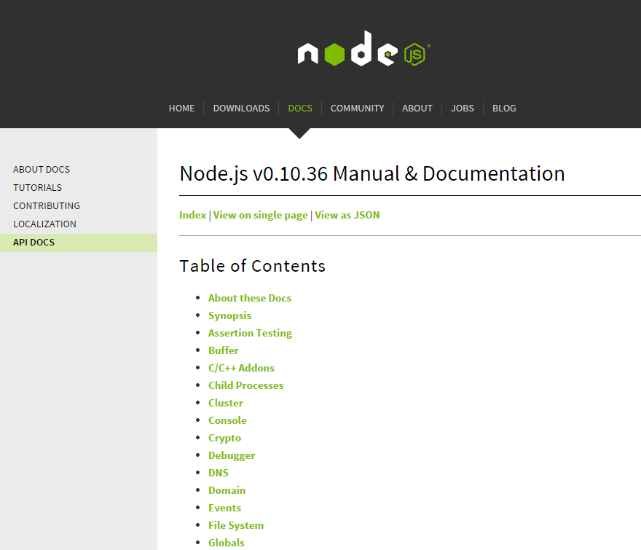
Node Official Documentation
http://nodejs.org/api/

Slide 173
MORE SOURCES
Diving into Node.js – Introduction and Installation
Understanding NodeJS
Node by Example
Let’s Make a Web App: NodePad
http://www.nodebeginner.org/
Notes:
http://stackoverflow.com/questions/5062614/how-to-decide-when-to-use-node-js

Slide 174
20 Lines Proxy Server
var http = require('http');
http.createServer(function(request, response) {
var proxy = http.createClient(80, request.headers['host'])
var proxy_request = proxy.request(request.method, request.url, request.headers);
proxy_request.addListener('response', function (proxy_response) {
proxy_response.addListener('data', function(chunk) {
response.write(chunk, 'binary');
});
proxy_response.addListener('end', function() {
response.end();
});
response.writeHead(proxy_response.statusCode, proxy_response.headers);
});
request.addListener('data', function(chunk) {
proxy_request.write(chunk, 'binary');
});
request.addListener('end', function() {
proxy_request.end();
});
}).listen(8080);
Notes:
http://www.catonmat.net/http-proxy-in-nodejs/

